Slide 1
Database Program

Slide 2

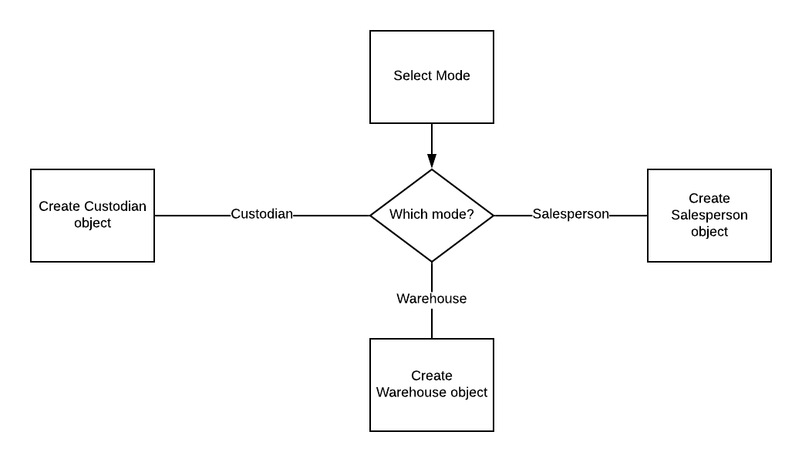
Program flow

Slide 3
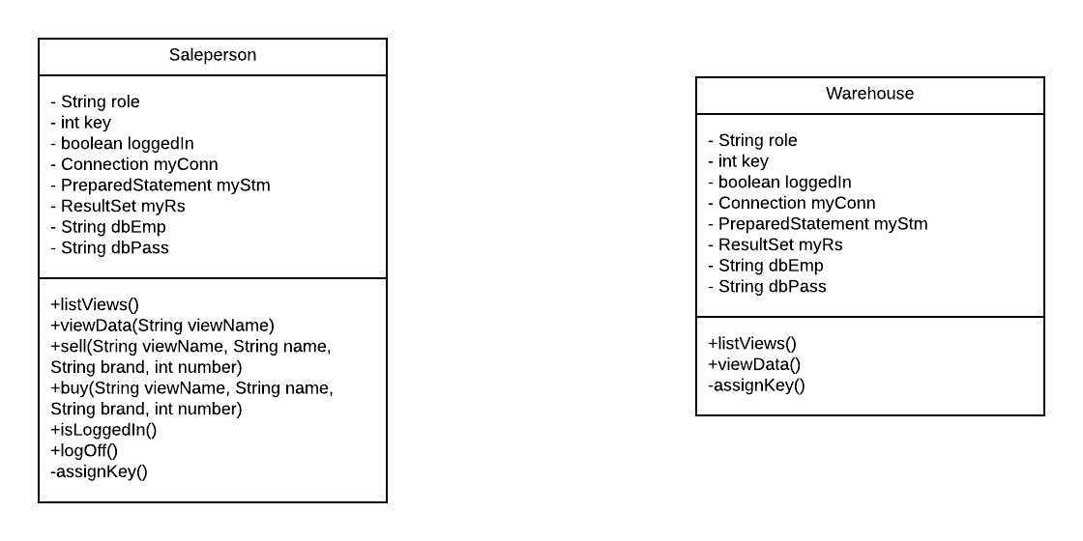
Salesperson object

Slide 4
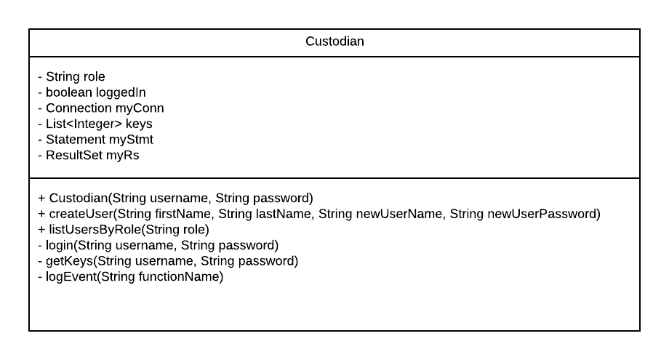
Custodian Object

